Slide 1
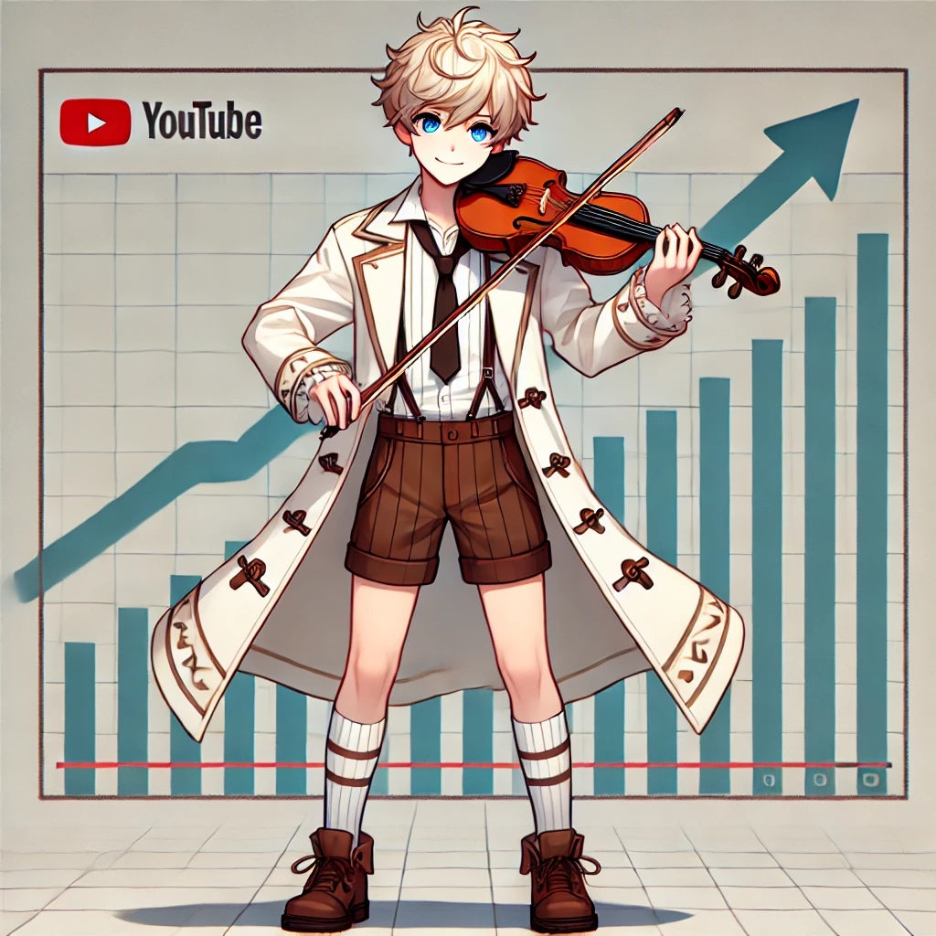
Notes:
A young character with short, tousled light blonde hair and bright blue eyes stands in a simple pose. He wears a white coat with brown accents over a white shirt and a black tie. The outfit includes brown shorts, white knee-high socks, and dark brown shoes. The overall look blends a playful style with a hint of formality, conveying a youthful yet polished appearance. 我拉小提琴(左手拿琴右手持弓左肩膀夾琴)。折線圖向上衝。觀看Youtube直播影片。圖中只有出現1個我。Emphasize it (日系畫風)

Slide 2
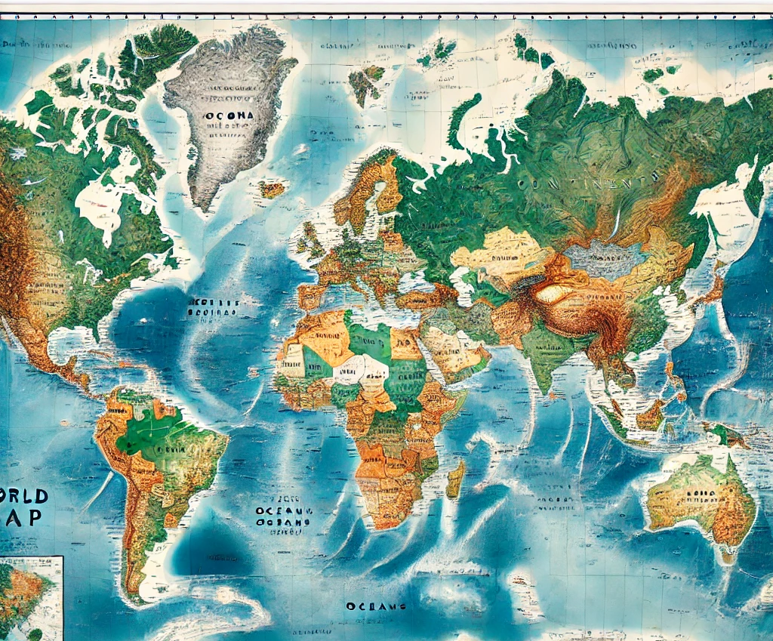
Notes:
世界地圖

Slide 3
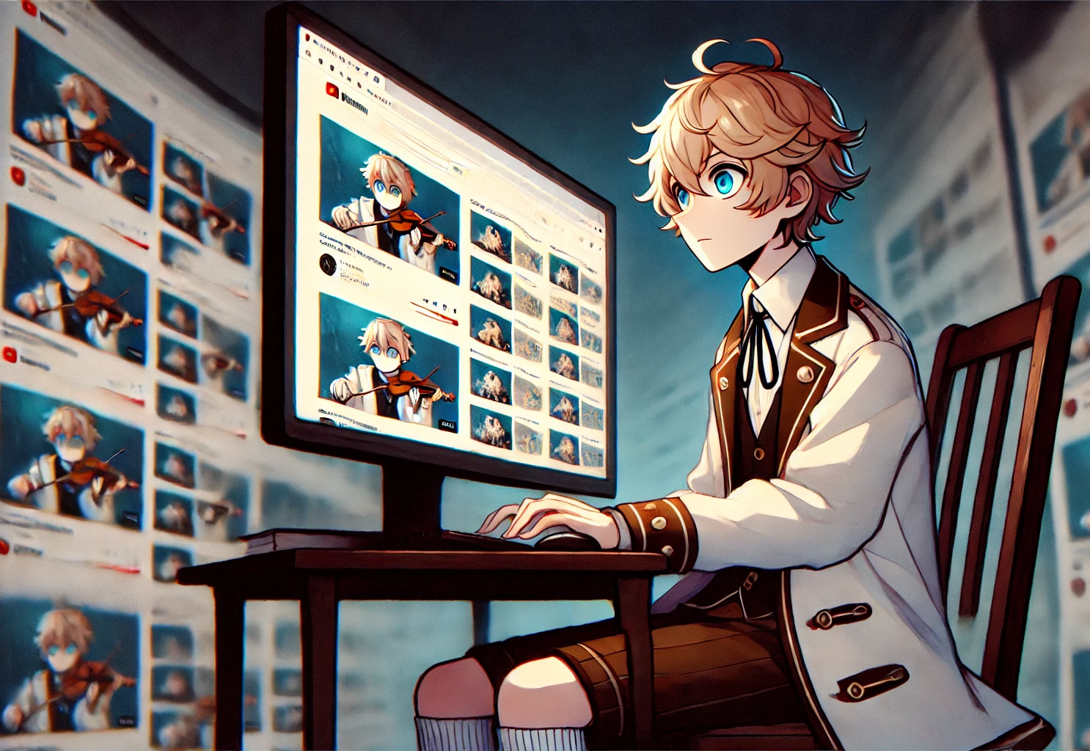
Notes:
A young character with short, tousled light blonde hair and bright blue eyes stands in a simple pose. He wears a white coat with brown accents over a white shirt and a black tie. The outfit includes brown shorts, white knee-high socks, and dark brown shoes. The overall look blends a playful style with a hint of formality, conveying a youthful yet polished appearance. 坐在電腦前，觀看自己的YouTube頻道(面向螢幕)。螢幕上是一個視訊影片的瀏覽介面，影片縮圖排列整齊但非常重複，都是我在拉小提琴的畫面，顯示內容同質化的問題。背景氣氛較沉重，表現出成長遇到瓶頸的挫折感。Emphasize it (日系畫風)

Slide 4
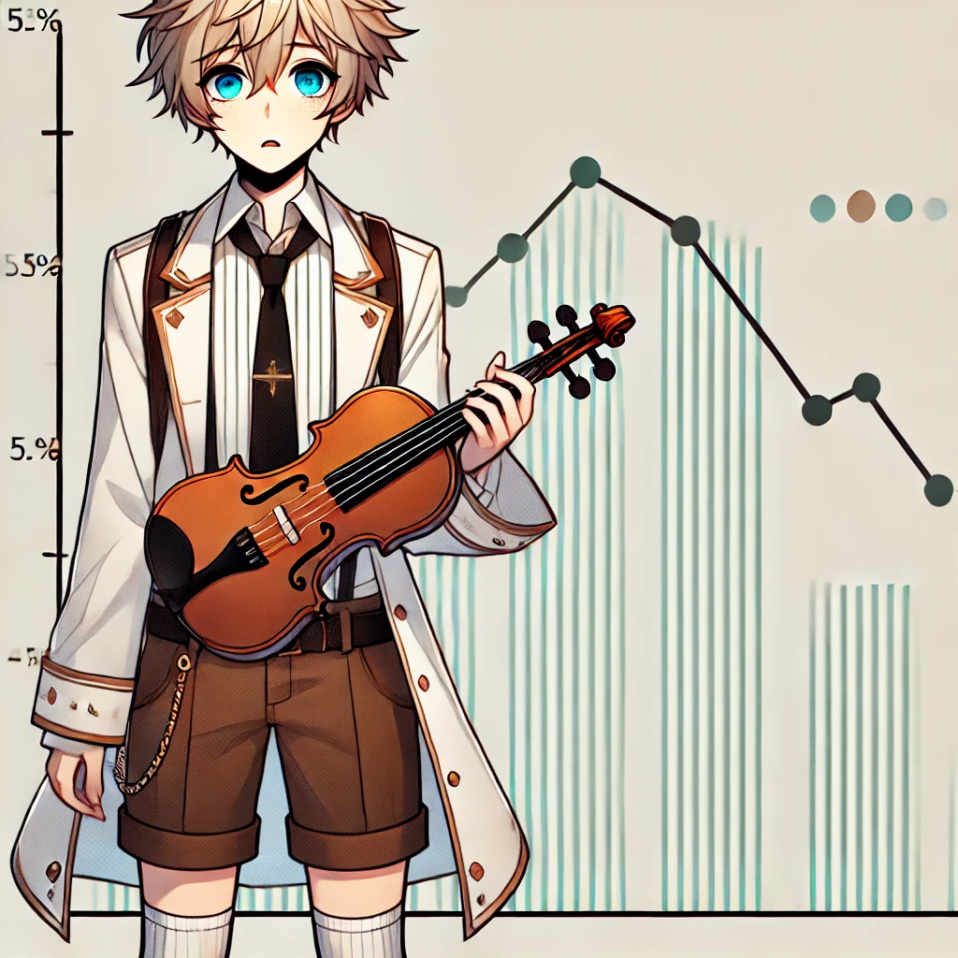
Notes:
A young character with short, tousled light blonde hair and bright blue eyes stands in a simple pose. He wears a white coat with brown accents over a white shirt and a black tie. The outfit includes brown shorts, white knee-high socks, and dark brown shoes. The overall look blends a playful style with a hint of formality, conveying a youthful yet polished appearance. 我拉小提琴(左手拿琴、右手持弓、左肩夾琴)、快哭出來的表情，非常苦惱。折線圖平平的、箭頭向右沒有成長。圖中只有1個人，圖中也只有1個我。Emphasize it (日系畫風)

Slide 5
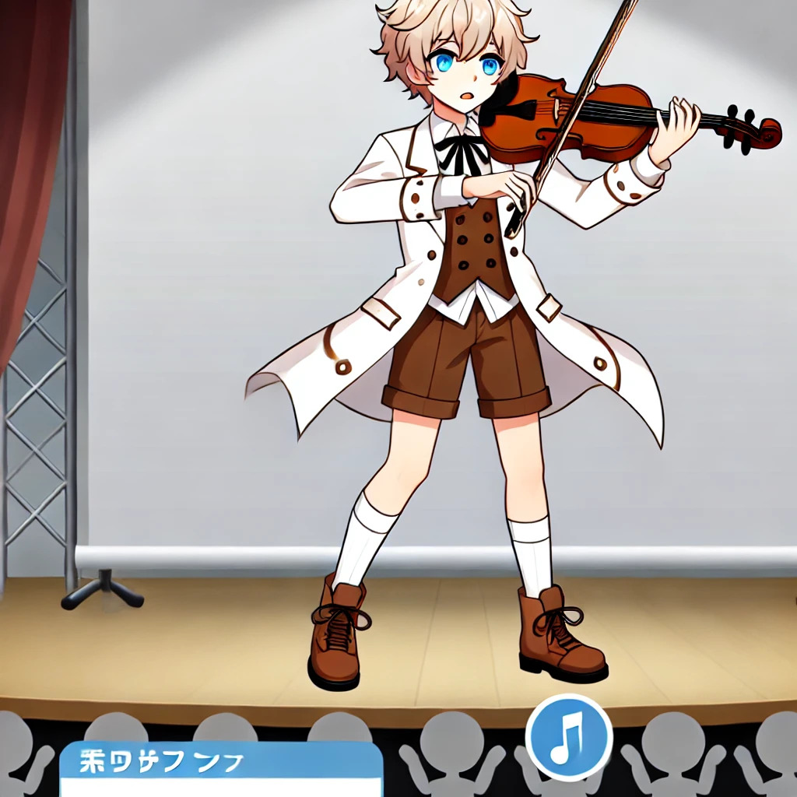
Notes:
A young character with short, tousled light blonde hair and bright blue eyes stands in a simple pose. He wears a white coat with brown accents over a white shirt and a black tie. The outfit includes brown shorts, white knee-high socks, and dark brown shoes. The overall look blends a playful style with a hint of formality, conveying a youthful yet polished appearance. . 小提琴音樂競賽，舞台，舞台下很多聽眾看我，拍手，沒有樂器。我在舞台上拉小提琴(左手拿琴、同時右手持弓、同時左肩膀夾琴)，錄影直播。圖中只有出現1個我。Emphasize it (日系插畫風)

Slide 6
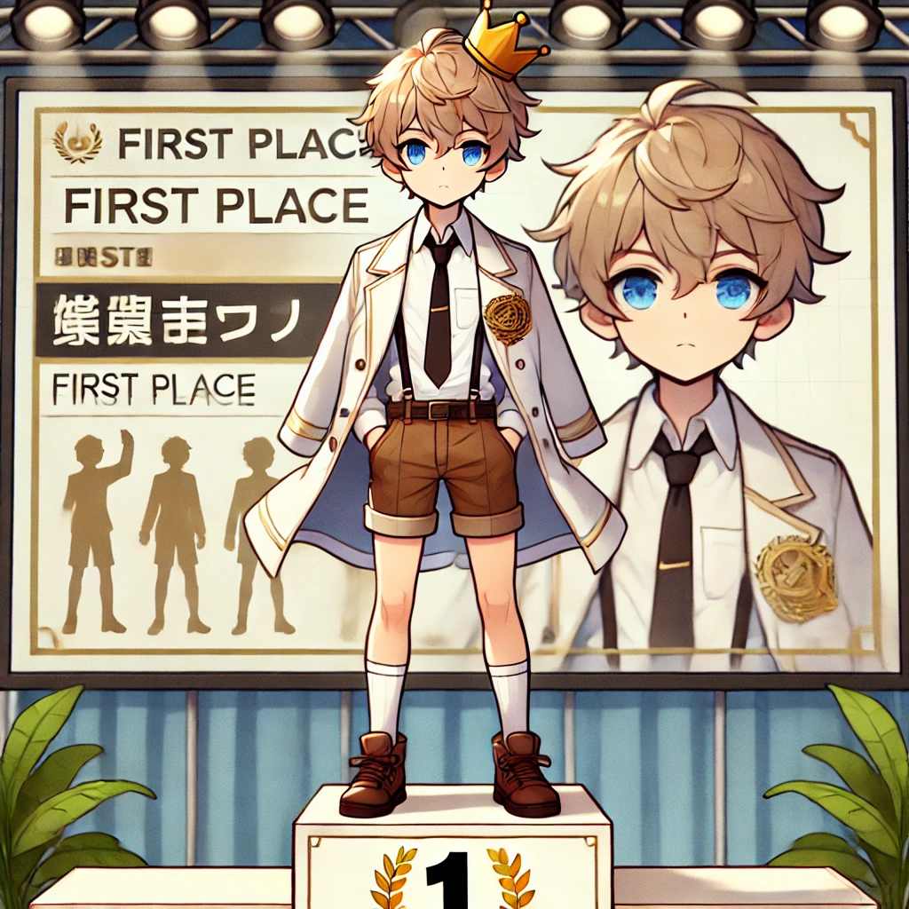
Notes:
A young character with short, tousled light blonde hair and bright blue eyes stands in a simple pose. He wears a white coat with brown accents over a white shirt and a black tie. The outfit includes brown shorts, white knee-high socks, and dark brown shoes. The overall look blends a playful style with a hint of formality, conveying a youthful yet polished appearance. 音樂競賽頒獎典禮。我在舞台上的頒獎台上第一名的位置(二三名是其他人)。頭上戴著王冠，象徵取得第一名。錄影直播。圖中只有出現1個我。Emphasize it (日系插畫風)

Slide 7
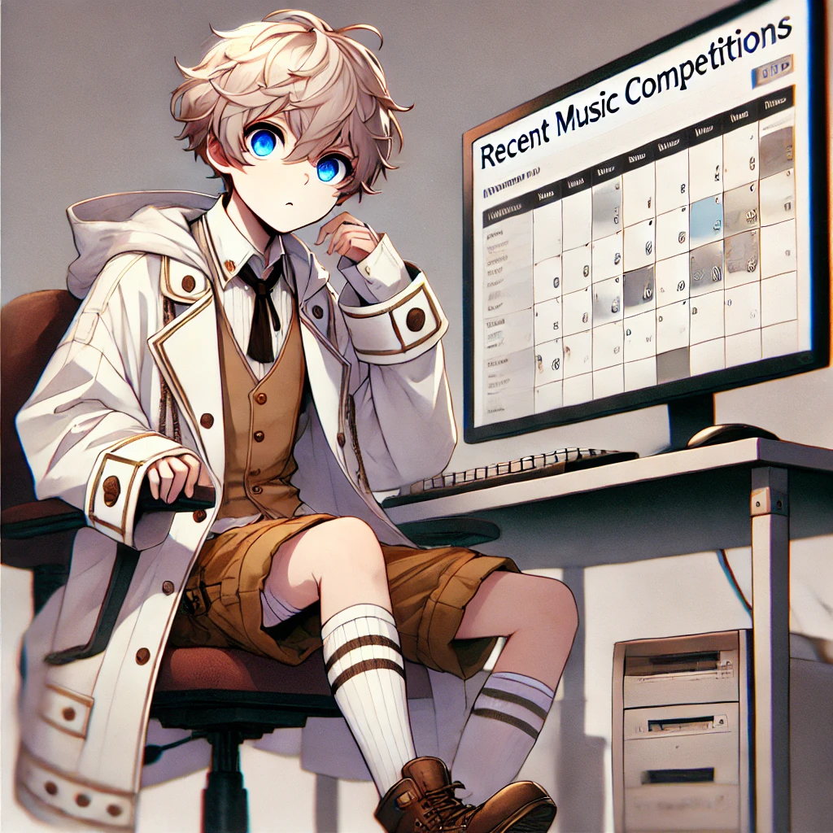
Notes:
A young character with short, tousled light blonde hair and bright blue eyes stands in a simple pose. He wears a white coat with brown accents over a white shirt and a black tie. The outfit includes brown shorts, white knee-high socks, and dark brown shoes. The overall look blends a playful style with a hint of formality, conveying a youthful yet polished appearance. 坐在電腦前，觀看近期音樂比賽列表(面向螢幕)。螢幕上是一個行事曆網頁，標題為近期音樂比賽列表，裡面是空的行事曆，顯示內容同質化的問題。背景氣氛較沉重，表現出成長遇到瓶頸的挫折感。Emphasize it (日系畫風)

Slide 8
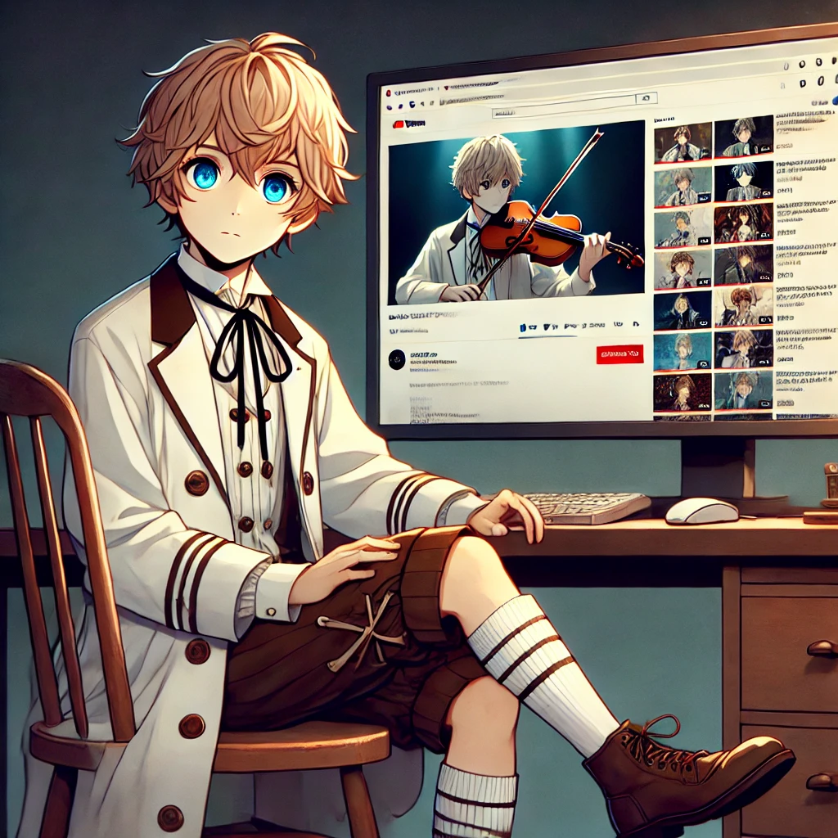
Notes:
A young character with short, tousled light blonde hair and bright blue eyes stands in a simple pose. He wears a white coat with brown accents over a white shirt and a black tie. The outfit includes brown shorts, white knee-high socks, and dark brown shoes. The overall look blends a playful style with a hint of formality, conveying a youthful yet polished appearance. 坐在電腦前，觀看自己的YouTube頻道(面向螢幕)。螢幕上是一個視訊影片的瀏覽介面，影片縮圖排列整齊但非常重複，有一個唯一明顯不一樣的影片，但是大部分的影片，都是我在拉小提琴的畫面，顯示內容同質化的問題仍在。背景氣氛較沉重，表現出成長遇到瓶頸的挫折感。Emphasize it (日系畫風)

Slide 9
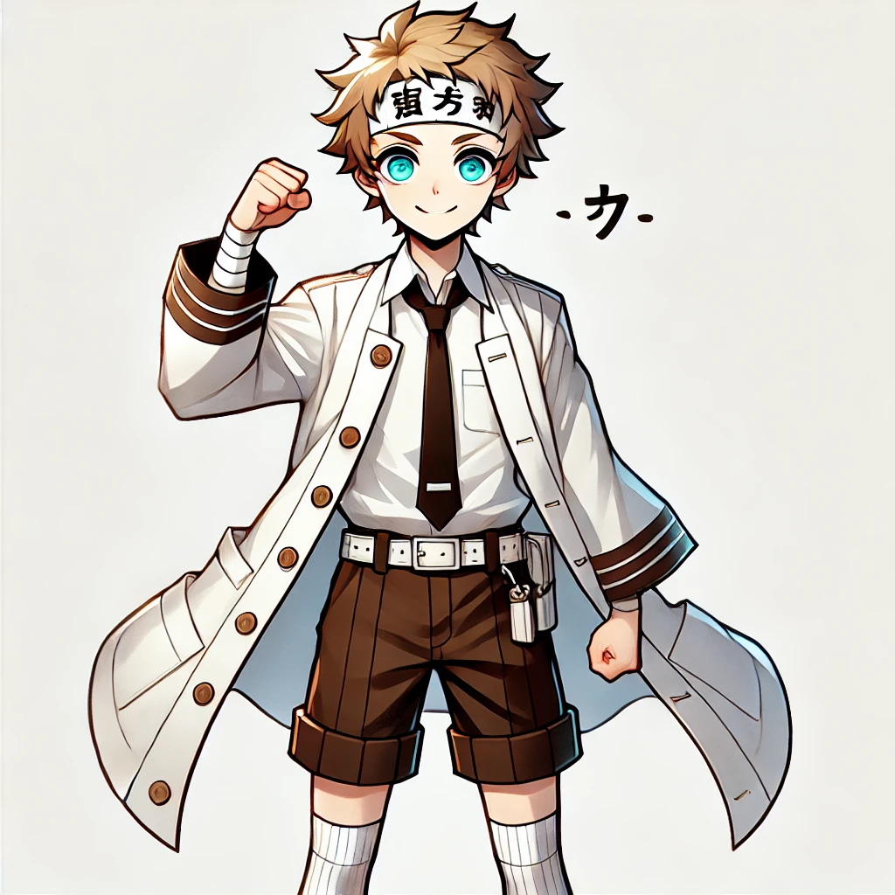
Notes:
A young character with short, tousled light blonde hair and bright blue eyes stands in a simple pose. He wears a white coat with brown accents over a white shirt and a black tie. The outfit includes brown shorts, white knee-high socks, and dark brown shoes. The overall look blends a playful style with a hint of formality, conveying a youthful yet polished appearance. 比出加油手勢、為自己加油打氣。頭戴必勝頭斤。畫面中「只有1個我」，不要亂加角色、也不要畫很多人，更不要畫一堆我、只要一個。Emphasize it (日系畫風)

Slide 10
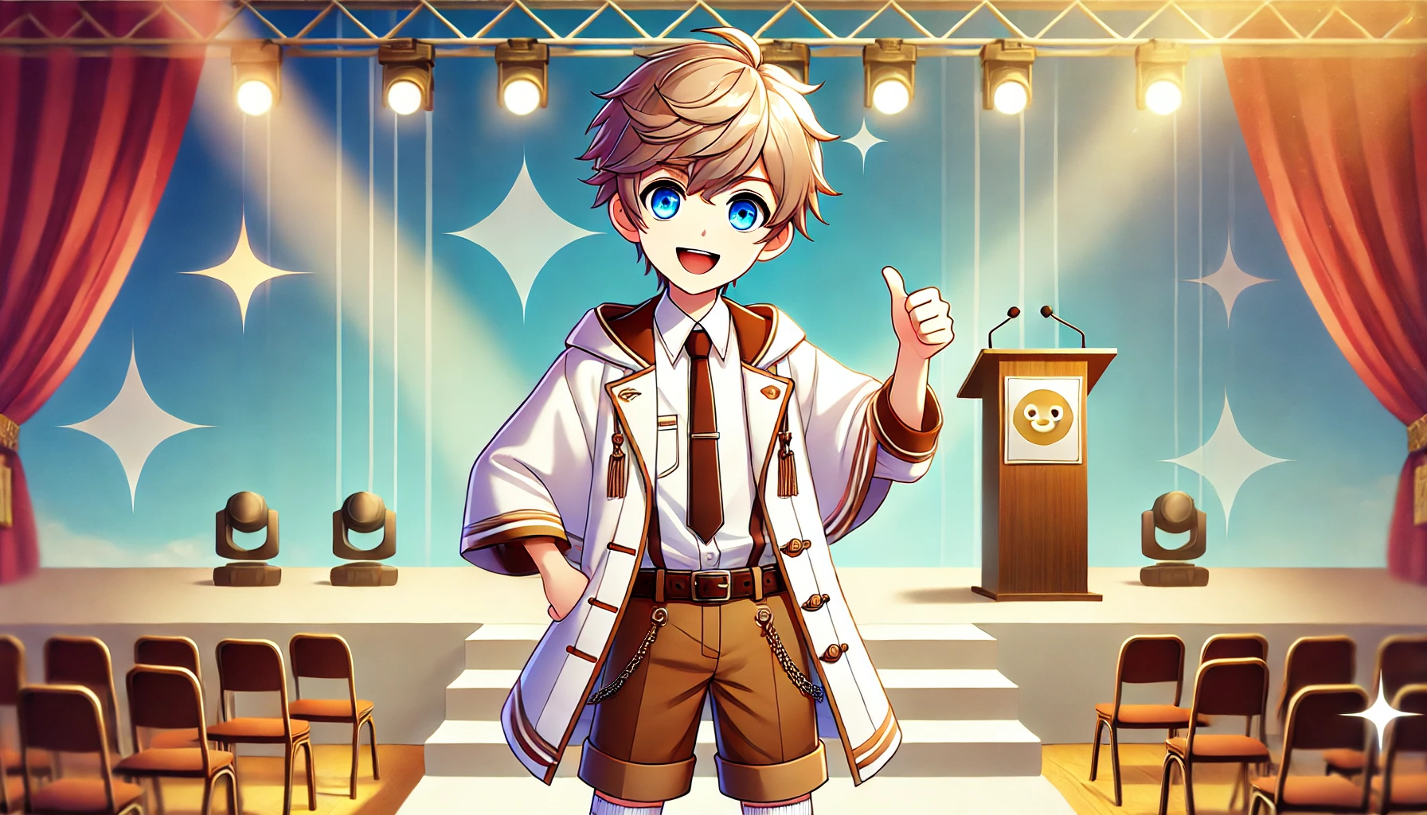
Notes:
A young character with short, tousled light blonde hair and bright blue eyes stands in a simple pose. He wears a white coat with brown accents over a white shirt and a black tie. The outfit includes brown shorts, white knee-high socks, and dark brown shoes. The overall look blends a playful style with a hint of formality, conveying a youthful yet polished appearance. 我背後有演唱會舞台，舞台上有頒獎台。我比讚！Emphasize it (日系畫風)

Slide 11


Notes:
A young character with short, tousled light blonde hair and bright blue eyes stands in a simple pose. He wears a white coat with brown accents over a white shirt and a black tie. The outfit includes brown shorts, white knee-high socks, and dark brown shoes. The overall look blends a playful style with a hint of formality, conveying a youthful yet polished appearance. 我背後有演唱會舞台，舞台上有頒獎台。我比讚！Emphasize it (日系畫風)

Slide 12
Notes:
A young character with short, tousled light blonde hair and bright blue eyes stands in a simple pose. He wears a white coat with brown accents over a white shirt and a black tie. The outfit includes brown shorts, white knee-high socks, and dark brown shoes. The overall look blends a playful style with a hint of formality, conveying a youthful yet polished appearance. 我背後有演唱會舞台，舞台上有頒獎台。我比讚！Emphasize it (日系畫風)

